Slide 1
MODIFICATIONS OF the PSA regulations BASED ON case studies of stability accidents
Arne Kvitrud
Petroleum Safety Authority Norway (PSA)

Slide 2
Accidents 2000-2013
Petrobras P-36 semi in 2001
Petrobras P-34 FPSO in 2002
Thunder Horse semi in 2005
Typhoon TLP in 2005
Aban Pearl semi in 2010
Deepwater Horizon semi in 2010
Jupiter 1 semi in 2011
Kolskaya jackup in 2011
Accident = Sank or more than 17 degrees list

Slide 3
Norwegian incidents 2000-2013
West Venture semi in 2000
Åsgard B semi in 2000
Polar Pioneer semi in 2002
Snorre B semi in 2003
Gjøa semi in 2010
Åsgard A FPSO in 2011
Scarabeo 8 semi in 2012
Floatel Superior semi in 2012
Island Innovator in 2013
Incident = Between 3 and 7 degrees list

Slide 4
Kolskaya – sank 2011

Slide 5
Jupiter 1 – sank 2011

Slide 6
Deepwater Horizon – sank 2010

Slide 7
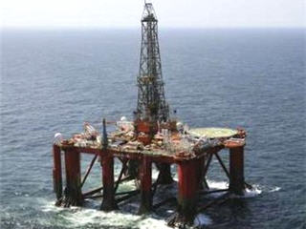
Aban Pearl – sank 2010

Slide 8
Thunder Horse – 2005

Slide 9
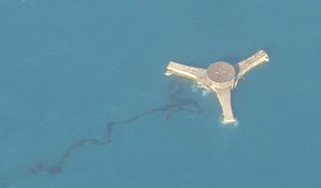
Typhoon – capsized 2005

Slide 10
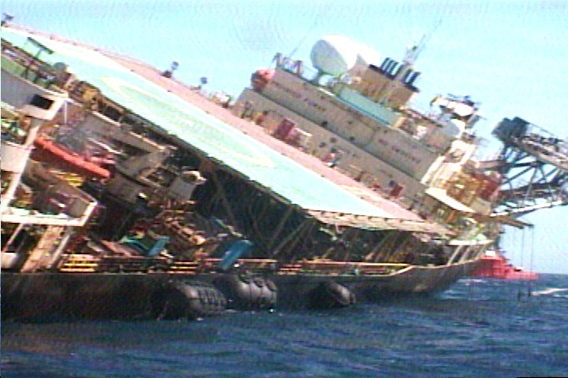
Petrobras P34 - 2002

Slide 11
Petrobras P36 – sank 2001

Slide 12
Intact stability requirements
No reasons for changes
Kolskaya?

Slide 13
Common causes of damage
1. Explosions
2. Fires
3. Deluge and fire water
4. Environmental loads or inadequate structural capacity.
5. Programming errors in the ballast system.
6. Openings in bulkheads may escalate situations.
7. Valves, either internal or towards sea, can malfunction.
8. Hydraulic power units can cause valves to open.
9. Improper ballasting caused by lack of expertise or training may lead to accidents.
10. Changes in weight and the centre of gravity can occur during storms.
11. Collisions and anchors hitting the hull.
12. Grounding during tow.

Slide 14
Hierarchy of Norwegian rules
Laws
Framework regulations
Facilities regulation
Norwegian maritime authorities regulations
NORSOK
DNV with N-notions
ABS with N-notions

Slide 15
Proposed and recent changes in Norwegian rules on stability
Analyse more accident cases
Snow and ice
Redundancy
Fire water and drain
Collision energies
Increase requirements to competence
Reduce number of opening in hulls

