Slide 1
Shuttle tanker collisions during offloading
Arne Kvitrud, Harald Kleppestø and
Odd Rune Skilbrei,
Petroleum Safety Authority (PSA),
Stavanger, Norway.

Slide 2
Shuttle tanker collisions during offloading
Cases 2000-2011:
2x Collisions
4x Near collisions
7x Position related incidents
Why didn’t all the cases end in a collision?
Which improvements are necessary?

Slide 3
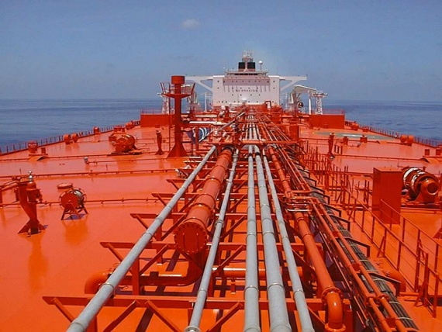
The Knock Sallie collision with Norne FPSO in 2000
150.000 dwt → 0.6 m/s → 31 MJ collision energy

Slide 4
Knock Sallie collision - causes
Software
Logic or programming errors in the DP-software.
Erroneous calculation of the “current” in the DP-software.
Quality of testing.
Required alarms not given.
Qualifications
The manning on the bridge was not according to procedure.
Training of personnel not performed according to procedures.
Lack of knowledge of the DP-system.
Unnecessary to perform “position drop out” tests on location.

Slide 5
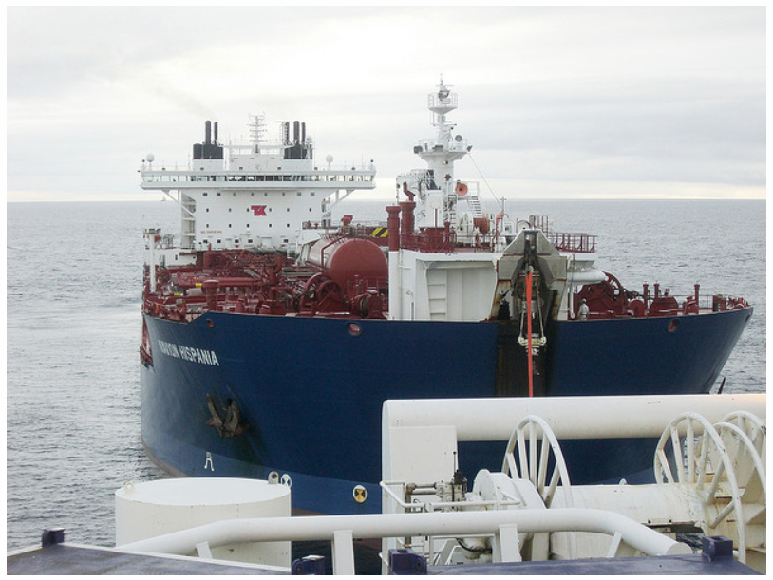
The Navion Hispania collision with Njord B FSU in 2006
126.000 dwt → 1.2 m/s → 61 MJ collision energy.

Slide 6
Navion Hispania collision - causes
Software
Errors in the control systems (software) for propellers.
During the blackout there was a cacophony of alarms on the bridge.
Technical
Incorrect signal wiring.
Qualifications
Inadequate knowledge of the Dynamic Positioning system.
“Autopos” mode maintained even after severe thruster failures.
Inadequate training in the DP failure modes.
Lack of compliance with procedures and errors in procedures.

Slide 7
Causes of incidents
Collisions: lack of knowledge or training and software errors occured in both cases.
Near collisions: software errors and lack of knowledge or training, together with not following procedures are found to be the causes for a majority of the cases.
Position incidents: equipment errors are dominating and are a part of the incident in six out of seven cases. Software errors and lack of maintenance is found for two of the cases.

Slide 8
Conclusion = new questions!
Q1 → Software
Q2 → Organization
Q3 → Distanse

Slide 9
The end!

Slide 10
Additional

Slide 11
Age
 | Average age of shuttle tankers
Collisions | 3,5 years
Near collisions | 10 years
Position events | 11 years

Slide 12
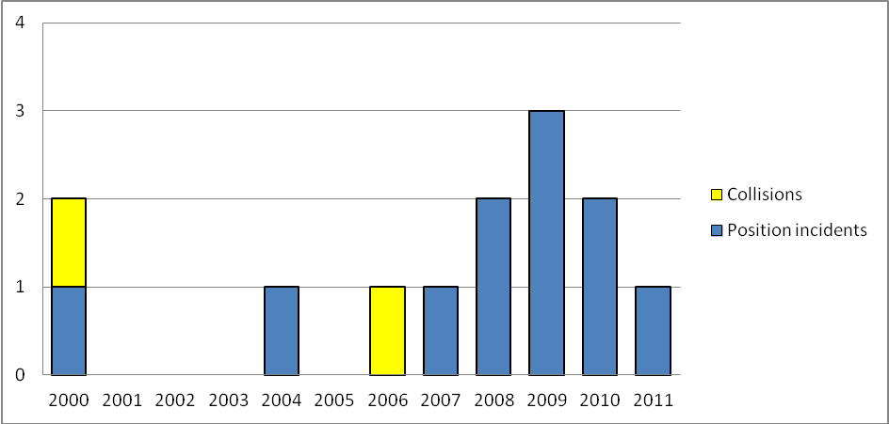
Development over time in Norway
High attention helps!!

Slide 13
PSA regulations and guidance
Personnel qualification and training on unintended situations.
Testing of systems.
Recommendations to DP classes.
Directional control.
Know relative position and direction.
Automatic stop in loading.
Shape of the stern of the FPSO /FSU.
No other vessel activity during tandem loading.

Slide 14
PSA regulations
Offloading systems | DP clas recommentations
Shuttle tanker loading from facilities handling hydrocarbons (FPSO/FSU). | 2
Shuttle tanker loading from subsea loading and off-loading installations where the shuttle tanker is not moored or anchored to these installations. | 2
Shuttle tanker loading from subsea loading and off-loading installations where the shuttle tanker is moored or anchored to these installations | Class 1 if the distance between associated facility and shuttle tanker is 2.5 km or more, otherwise class 2.
Loading operations from buoys (moored by hawser). | 1

Slide 15
The most common causes
a) The procedures and instructions are not followed.
b) The crew on the bridge are not adequately trained to use technical equipment on the bridge in emergency situations. The crew has too much confidence in the systems, and when errors occur, the crew are not sufficiently attentive or trained to correct errors in time.
c) Several incident investigations are pinpointing malfunction of equipment, due to errors in design, insufficient quality of the testing or commissioning. The severity of incidents seems to be inverse proportional to the age of the colliding shuttle tankers.
d) Some reports highlight inadequate maintenance systems.

